Slide 1
The Invasion that Never Happened
UFO Sightings and Sociological trends in Post-WW2 America

Slide 2
GOAL: Examining political and pop-culture moments during the 20th Century and their relation to the frequency of UFO sightings

Slide 3
The Dataset
Taken from National UFO Reporting Center (NUFORC)
Founded in 1974
“Primary function over the past five decades has been to receive, record, corroborate and document reports from individuals who have been witness to unusual, possibly UFO-related”
Pre-aggregated corpus of UFO sightings from 1910 to 2015 with ~83,000 entries
Reports are gathered through: Newspapers, Telephone hotline, Mail-in reports, Email and Website(after 1995)

Slide 4
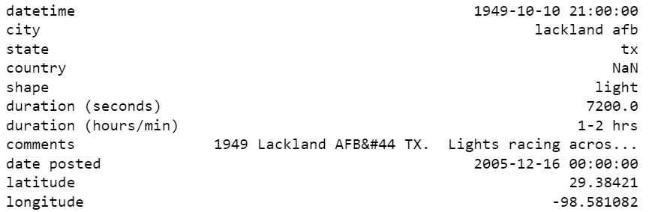
Example of an item in the dataset

Slide 5
Cleaning data

Slide 6

Narrowing from Global to US

Slide 7
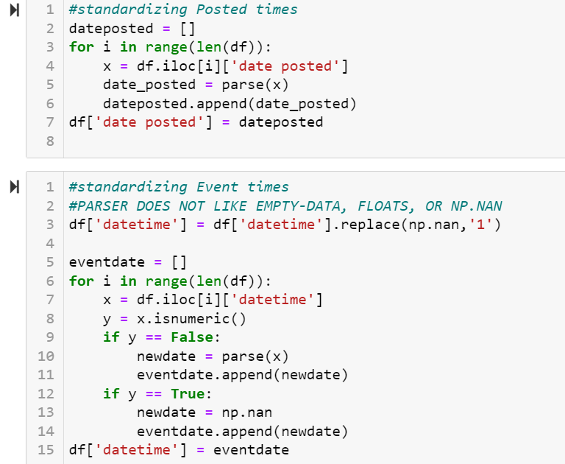
Standardizing Times to Datetime Format

Slide 8

Renaming:
‘datetime’ => ‘event time’
df => amer

Slide 9
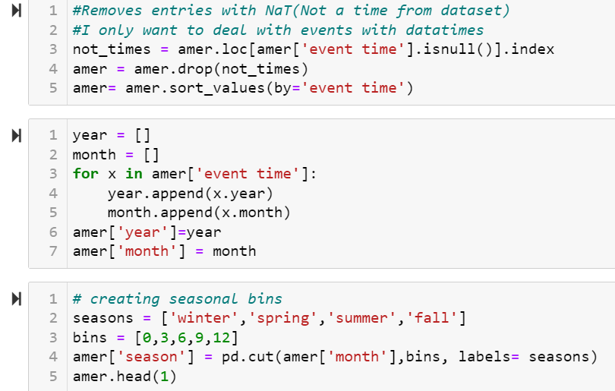
Removes non-dated items
Creates season, year,and month attributes

Slide 10
Background

Slide 11
Background: Pop Culture
What is it?
“the beliefs and practices, and the objects through which they are organized, that are widely shared among a population”(Mukerji, Schudson)
The post-war period how we related to culture changes:
Increased wages due to labor scarcity => expendable income
Centralization of media by the young entertainment industries (aka. Hollywood)(Grindstaff, 2008)
Decreased Creation of culture => Increased Consumption
Shared cultural experiences: News Movies, TV, Radio, Internet

Slide 12
Background: The Cold War
Distrust of the USSR starting the postwar period
Rise of conspiracy theories
Threat of Russian agents on US soil
Domestically, the Red Scare led to paranoia of communism in US
Development of HUAC (Communist Witchhunt)
The establishment of the US Air Force in 1947 for increased vigilance and airspace security
Ultimately affecting the US popular psyche
Creation of pop culture based on fear of invasion:
Invasion of the body snatchers(1956)
War of the Worlds movie(1953)

Slide 13
20th Century Moments

Slide 14
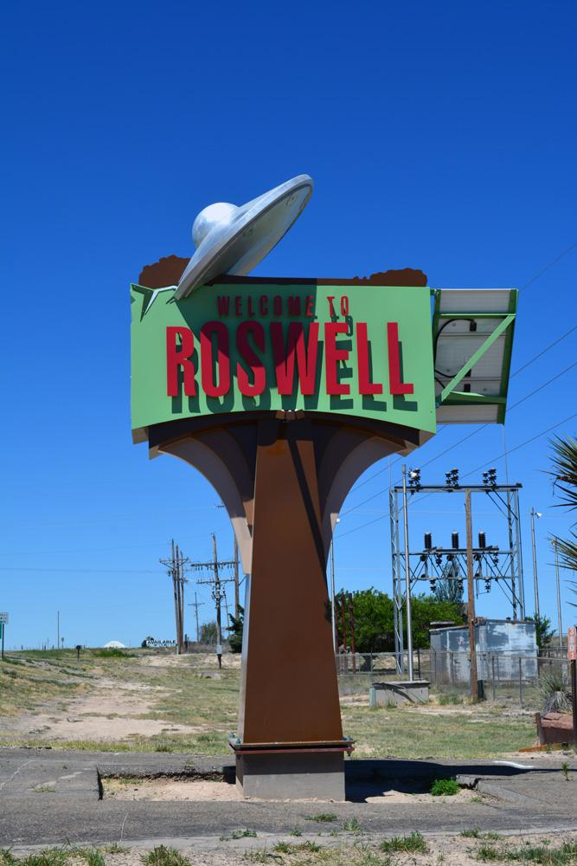
1947: Roswell,and Kenneth
The Kenneth Arnold Incident:
June 25, 1947
Civil Air pilot comes into contact with a shining object over Mt.Rainier
Starts the ‘1947 Flying Disc Craze’
The Roswell Incident:
July 8, 1947
Roswell Army Airfield announce the recovery of a "flying disc"
Russians? Little Green Men?

Slide 15
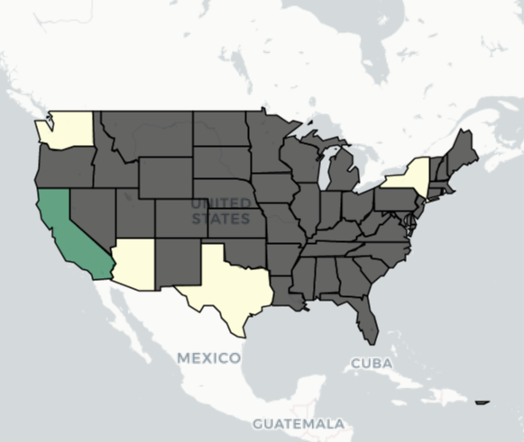
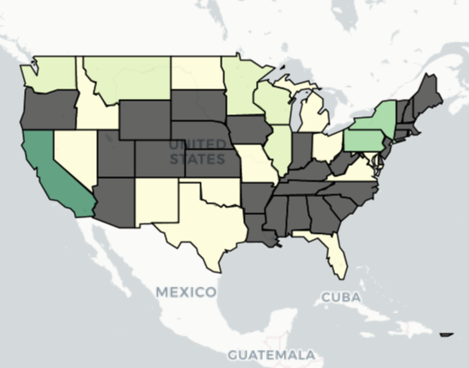
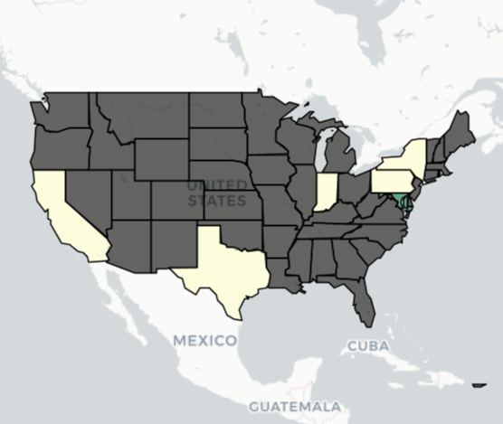
1947: Roswell,and Kenneth Arnold
1946:
7 sightings
1947:
31 sightings
1948:
7 sightings

Slide 16
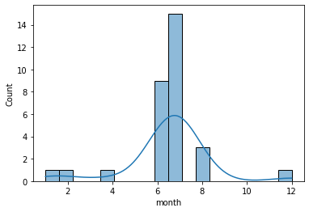
1947: Roswell,and Kenneth Arnold
1947 by month

Slide 17
1977-82, Aliens hit the Cinema
The late 70’s Alien movie boom : 4 year period of Successful releases
Movie | Release | Time in Theater | Box Office Revenue
Star Wars: A New Hope | May 25, 1976 | Six months | 775.8 million USD
Close Encounters of the Third Kind | December 16, 1977 | Three months | 306.9 million USD
Alien | December 16, 1979 | Four month | 184.7 million USD
Star Trek: the Motion Picture | December 7, 1979 | Three months | 139 million USD
Star Wars: the Empire Strikes Back | May 21, 1980 | Four months | 549 million USD

Slide 18
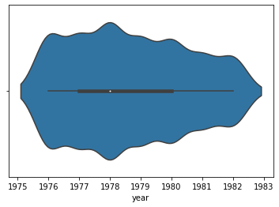
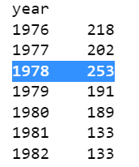
1977-82, Aliens hit the Cinema

Slide 19
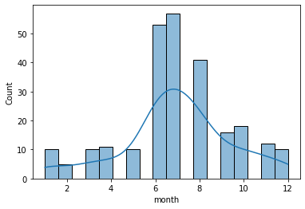
1977-82, Aliens hit the Cinema
1978 by month

Slide 20
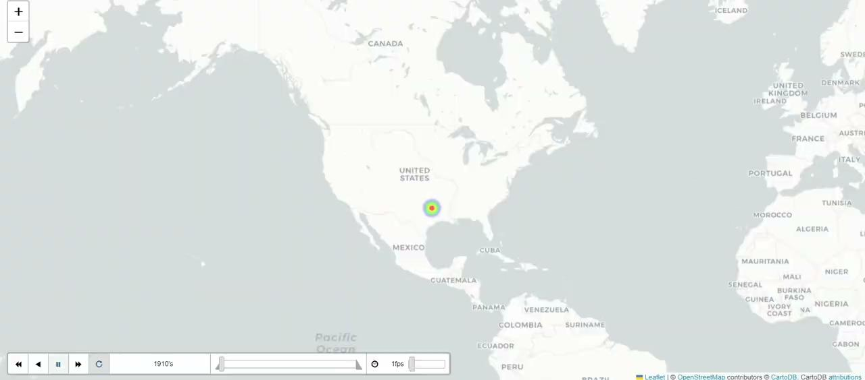
1910-2015: General Increase

Slide 21
Conclusion
It is unclear if there is a direct correlation between Alien based Media and UFO sightings
However, there is a sense that the media can color our perception of events
Leading some to claim an experience is supernatural

Slide 22

Find UFOs near you!!!

Slide 23
Sources
Grindstaff, Laura. (2008). Culture and Popular Culture: A Case for Sociology. The ANNALS of the American Academy of Political and Social Science. 619. 206-222. 10.1177/0002716208318520.
Mukerji, Chandra, and Michael Schudson. “Introduction: Rethinking Popular Culture.” Rethinking Popular Culture: Contemporary Perspectives in Cultural Studies, University of California Press, Los Angeles, CA, 2008.
UFO Sightings, NUFORC, 2020, https://www.kaggle.com/datasets/NUFORC/ufo-sightings. Accessed 2023.
United States, Congress, Division of Information and Marketing Services, and Richard Schumann. Compensation from World War II through the Great Society, Bureau of Labor Statistics, 2003. Compensation and Working Conditions.

